Slide 1
Miroslav Popovic
Building production-ready APIs with ASP.NET Core 3.0

Slide 2
Introduction

Slide 3
REST(ful)
REST
architecture type that’s using the existing web infrastructure
RESTful
services that implement REST architecture
Web resources – identified with URL address
HTTP verbs – GET, POST, PUT, DELETE, PATCH…
JSON or XML
Strict and pragmatic approach

Slide 4
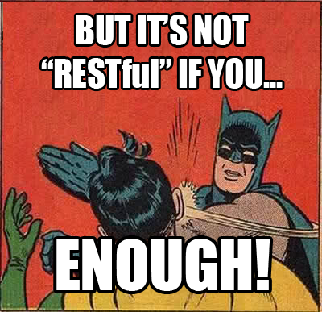

Slide 5

ASP.NET Core Benefits
Performance
Cross-platform
Open source
Dependency injection
Middleware / action filters
Endpoint routing (conventions and attributes)
Model binding and content negotiation (JSON, XML,…)

Slide 6
ASP.NET Core Benefits (cont.)
Configuration
environment specific
user secrets…
Logging
Security
Embedded authorization
HTTPS by default
Conventions
[ApiController]
ActionResult<T>
Analyzers

Slide 7
ASP.NET Core 3.0
Endpoint routing changes
HostBuilder instead of WebHostBuilder
New JSON API
Utf8JsonReader, Utf8JsonWriter, JsonDocument, JsonSerializer
Json.NET removed from shared framework
New MVC service registration methods
AddControllers()
SPA authentication with IdentityServer

Slide 8
Production-ready?

Slide 9
Best practices
IActionResult, ActionResult<T>
View Models
Model / input validation
Exception handling
Logging
Paging

Slide 10
Security
HTTPS
OAuth 2.0
Token based authentication
IdentityServer 4
https://identityserver.io/
Third party
Auth0 - https://auth0.com/
Okta - https://developer.okta.com/
…
Notes:
https://docs.microsoft.com/en-us/aspnet/core/migration/1x-to-2x/identity-2x

Slide 11
Testing
Unit testing & Integration testing
Manual testing
Tools (Postman, Fiddler…)
Stress/load testing
https://loader.io/,
https://artillery.io/,
https://gatling.io/, https://websurge.west-wind.com/ …

Slide 12
Documentation
http://swagger.io/ -> https://www.openapis.org/
Swagger -> Open API Specification 3.0
API framework
Docs
Define an API
Automate API testing
Code generation
...
API Analyzers - Microsoft.AspNetCore.Mvc.Api.Analyzers
Swashbuckle or NSwag and Swagger UI

Slide 13

Rainbows and unicorns
Image source: https://www.percussion.com/blog/2015/March/unicorns-and-rainbows-wont-help-your-social-media-data-will

Slide 14
Usage limiting
Limit per token
With middleware or action filter
https://github.com/stefanprodan/AspNetCoreRateLimit
Limit per Client IP
Limit per Client ID header

Slide 15
Versioning
URL
/api/v2/games/
Query string
/api/games?api-version=2
Custom request header
api-version: 2
Accept header
Accept: application/json;v=2
Microsoft.AspNetCore.Mvc.Versioning
Supports all types, query string by default (?api-version=2)

Slide 16
Monitoring
Simple logging – errors, logs
Performance tracking
Usage tracking
Azure – Azure Monitor, Application Insights, Log Analytics …
Open-source - Prometheus, Grafana…
ASP.NET Core Health Checks
https://github.com/Xabaril/AspNetCore.Diagnostics.HealthChecks/
Third-party monitoring services
https://newrelic.com/
https://stackify.com/
https://www.datadoghq.com/
…

Slide 17
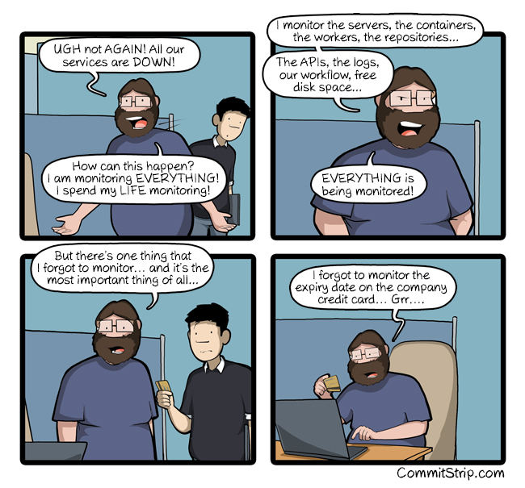

Slide 18


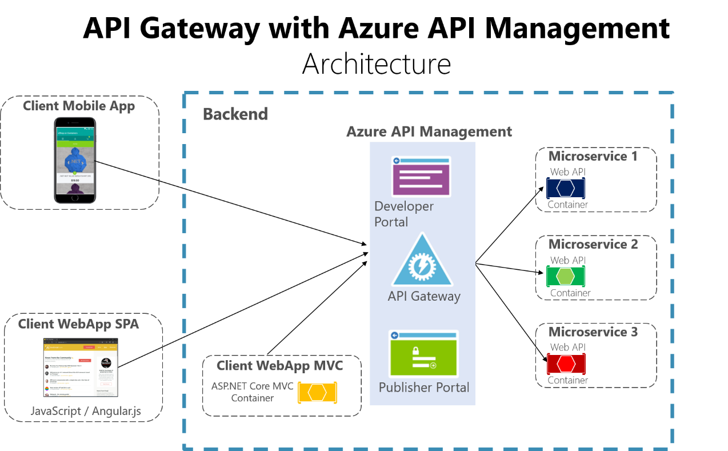
API Gateways
Features
Routing
Request Aggregation
Service Discovery with Consul & Eureka
Service Fabric
Kubernetes
WebSockets
Authentication
Authorisation
Rate Limiting
Caching
Retry policies / QoS
Load Balancing
Logging / Tracing / Correlation
Headers / Query String / Claims Transformation
Custom Middleware / Delegating Handlers
Configuration / Administration REST API
Platform / Cloud Agnostic

Slide 19
Closing up

Slide 20
Summary
Basics – REST, ASP.NET Core
Best practices
Security
Testing
Documentation
Limiting
Versioning
Monitoring
API Gateways

Slide 21
Further reading
https://github.com/microsoft/api-guidelines
Specifications
HATEOAS – Hypermedia as the Engine of Application State
https://ionwg.org/ - The ION Hypermedia Type
http://jsonapi.org/ - JSON API Specification
http://json-schema.org/ - JSON (Hyper-)Schema...
http://graphql.org/ - GraphQL
APIs
https://dev.twitter.com/rest/public - Twitter REST
https://developer.github.com/v3/ - GitHub REST / v4 GraphQL
https://stripe.com/docs/api - Stripe
https://www.twilio.com/docs/api/rest - Twilio

Slide 22
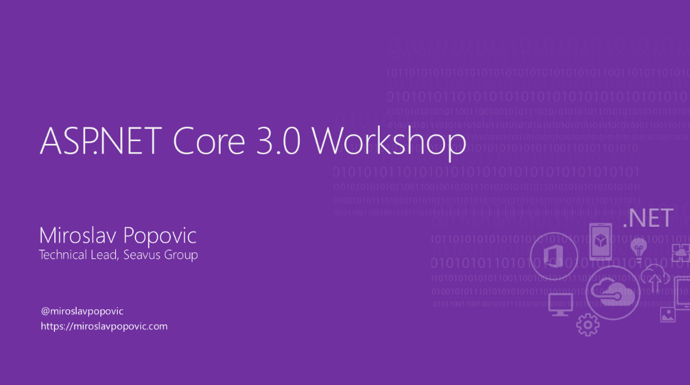
Samples
https://github.com/nbarbettini/BeautifulRestApi
samples and video course
https://github.com/dodyg/practical-aspnetcore
300+ ASP.NET Core samples
https://github.com/miroslavpopovic/production-ready-apis-sample-3
https://github.com/miroslavpopovic/aspnetcore-workshop

Slide 23
Thank you!
Questions?
https://miroslavpopovic.com
@miroslavpopovic

